Slide 1


HOSPITAL MANAGEMENT SYSTEM A DBMS PROJECT
SUBMITTED BY: Aanchal (19124002)
Jahnavi (19124029)
SUBMITTED TO : Dr. Amritpal Singh

Slide 2


Hospital Management System
In this project , we have developed a database for hospital management system. The main aim to develop this is to store the details of patients, doctors, staff working in the hospital. As well as it stores the information of which patient is consulting which doctor based on their respective diseases.
The main purpose of this type of database is to reduce the manual error involved in storing all these details. Due to automation, many loopholes that exist in the manual maintenance of the records can be removed.
It can be used in nay hospital, clinic or dispensary for maintaining patient details and their results.

Slide 3
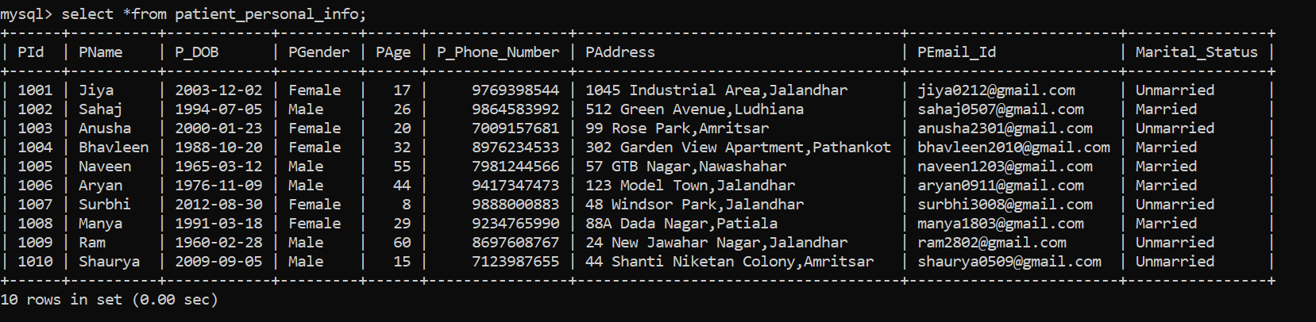
Patient Personal Information Table
Create table PATIENT_PERSONAL_INFO(PId int(5) Primary Key,PName varchar(25)Not Null,P_DOB date,PGender Enum ('Male','Female'),PAge int(3),P_Phone_Number bigint(11) Unique,PAddress varchar(255),PEmail_Id varchar(50) Unique,Marital_Status Enum('Married','Unmarried'));

Slide 4
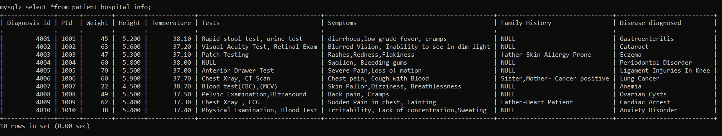
Patient Hospital Management Table
Create table PATIENT_HOSPITAL_INFO(Diagnosis_Id int(5) Primary Key,PId int(5),Weight int(3) Check(Weight>0),Height Decimal(5,3),Temperature decimal(4,2),Tests varchar(255),Symptoms varchar(255) Not Null,Family_History varchar(255) Default Null,Disease_diagnosed varchar(50),Foreign Key(PId) References PATIENT_PERSONAL_INFO(PId),Constraint Symptom_check Check(Symptoms Is Not Null));

Slide 5
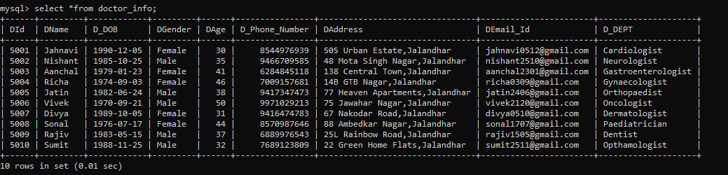
Doctor Information Table
Create table DOCTOR_INFO(DId int(5) Primary Key,DName varchar(25) Not Null,D_DOB date,DGender Enum ('Male','Female'),DAge int(3),D_Phone_Number bigint(11) Unique,DAddress varchar(255),DEmail_Id varchar(50) Unique,D_DEPT varchar(25));

Slide 6
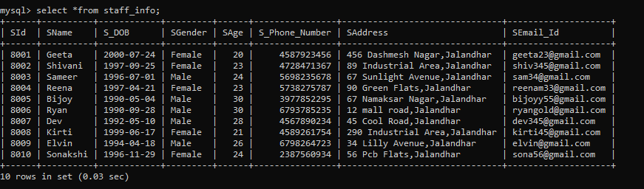
Staff Information Table
Create table STAFF_INFO(SId int(5) Primary Key,SName varchar(25) Not Null,S_DOB date,SGender Enum ('Male','Female'),SAge int(3),S_Phone_Number bigint(11) Unique,SAddress varchar(255),SEmail_Id varchar(50) Unique Default NULL);

Slide 7
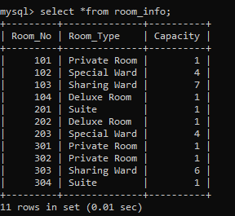
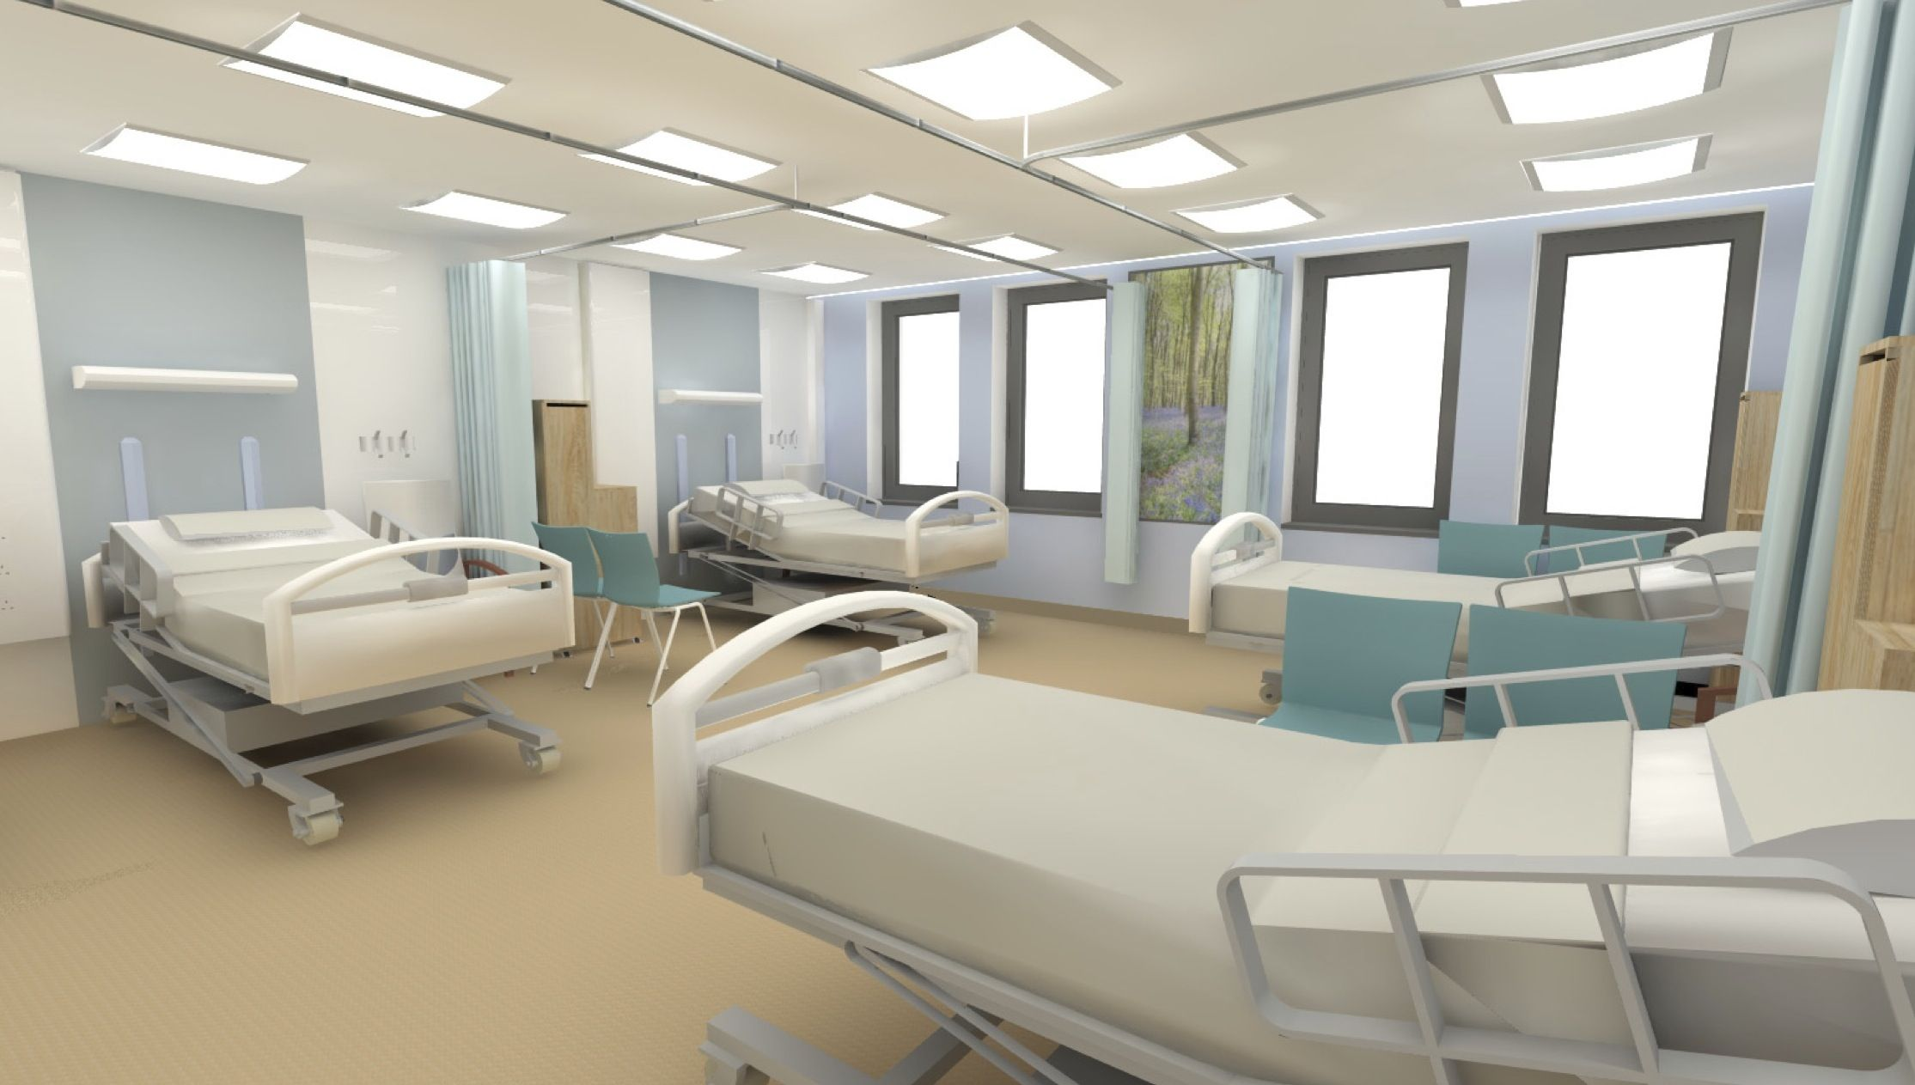
Room Information Table
Create table ROOM_INFO(Room_No int(4) Primary Key, Room_Type varchar(25),Capacity int(3));

Slide 8
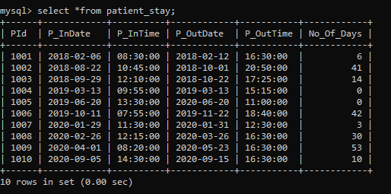
Patient Stay Information Table
Create table PATIENT_STAY(PId int(5),P_InDate date,P_InTime time,P_OutDate date,P_OutTime time,No_Of_Days int(3),Foreign Key(PId) References PATIENT_PERSONAL_INFO(PId));

Slide 9
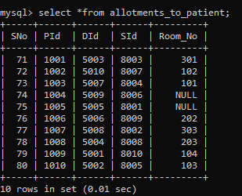
Allotments To Patients Table
Create table ALLOTMENTS_TO_PATIENT(SNo int(5) Primary key,PId int(5),DId int(5),SId int(5),Room_No int(4),Foreign Key(PId) References PATIENT_PERSONAL_INFO(PId),Foreign Key(DId) References DOCTOR_INFO(DId),Foreign Key(SId) References STAFF_INFO(SId),Foreign Key(Room_No) References ROOM_INFO(Room_No));

Slide 10
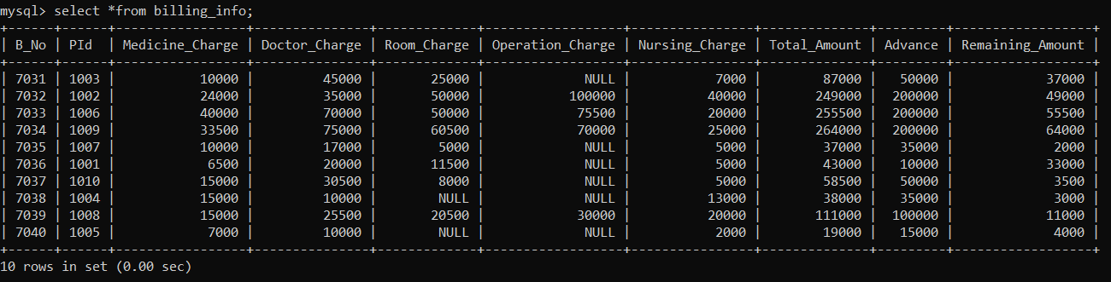
Billing Information Table
Create table BILLING_INFO(B_No int(5) Primary Key Auto_Increment,PId int(5),Medicine_Charge int(10),Doctor_Charge int(10),Room_Charge int(10),Operation_Charge int(10),Nursing_Charge int(10),Total_Amount int(10),Advance int(10),Remaining_Amount int(10),Foreign Key(PId) References PATIENT_PERSONAL_INFO(PId));

Slide 11
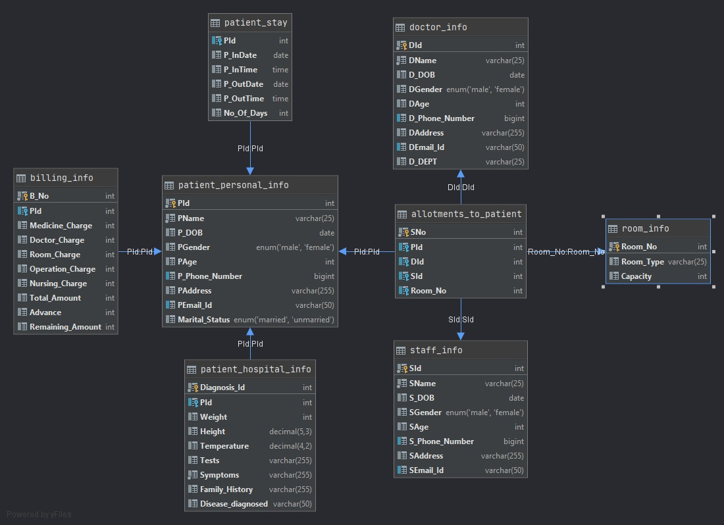
ER DIAGRAM

Slide 12
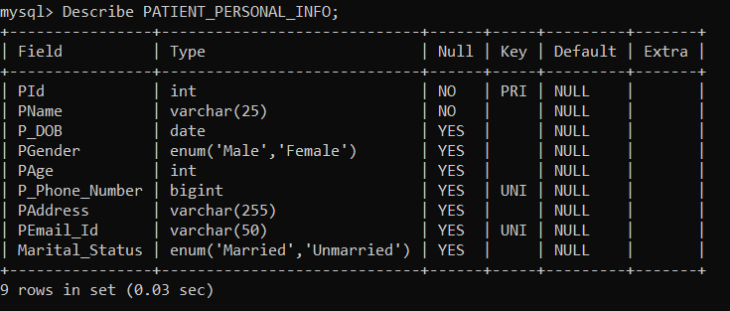
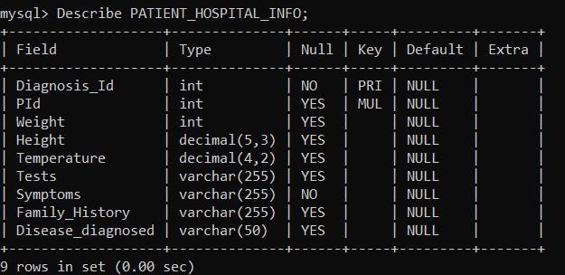
Description of Databases

Slide 13
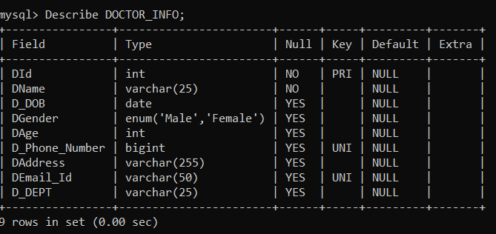
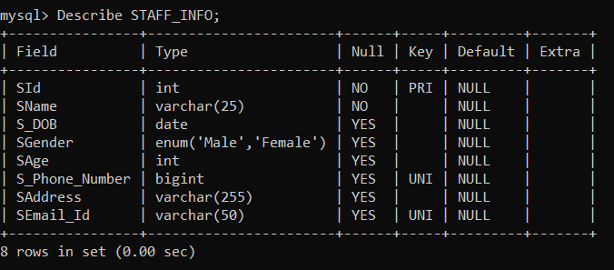
Description of Databases…

Slide 14
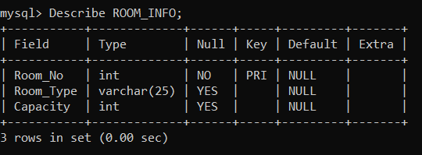
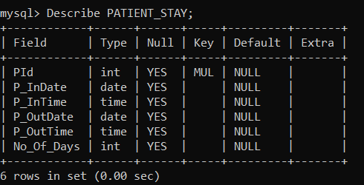

Slide 15
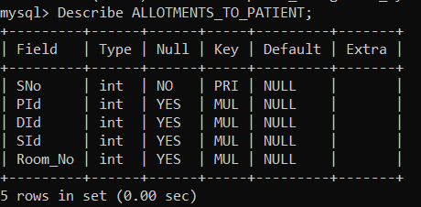
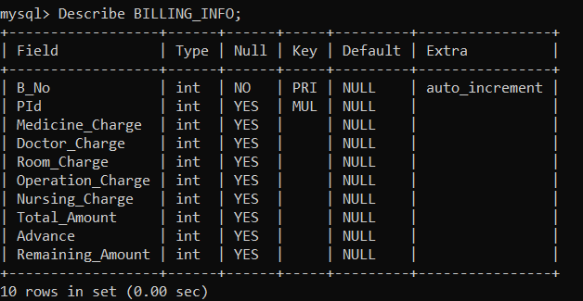

Slide 16
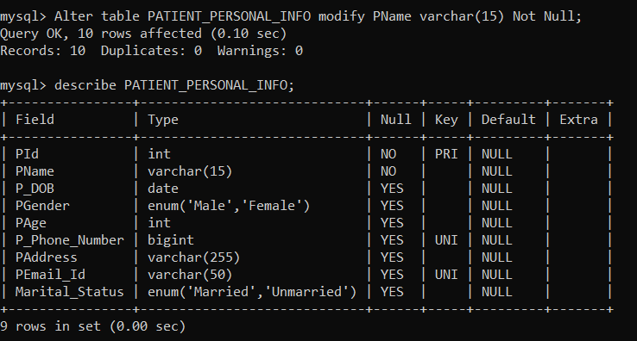
QUERIES
To modify Pname from null to not null

Slide 17
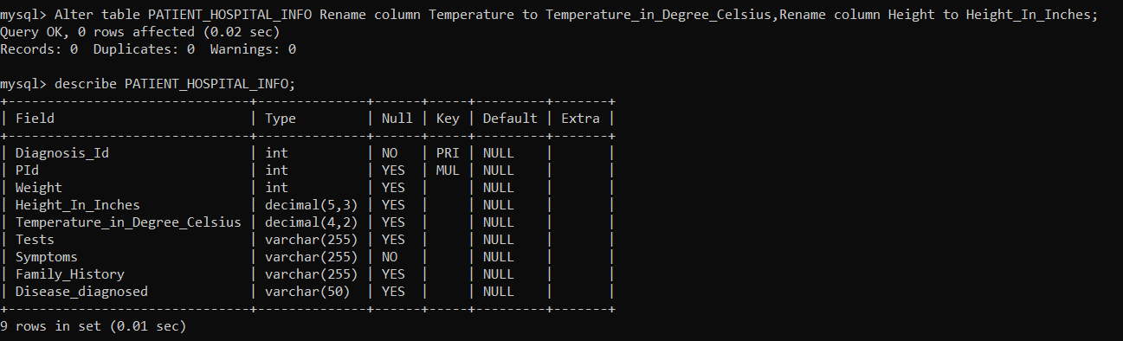
To change the column name of temperature , height of Patient_hospital_info table

Slide 18
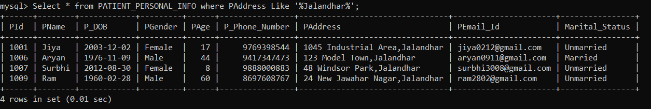
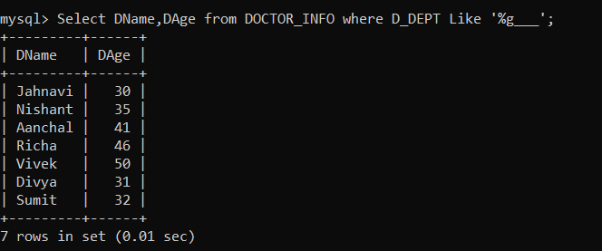
To display all columns of rows having ‘Jalandhar’ in the address
• To display name and age of doctors whose department has letter ‘g’ as the fourth last value

Slide 19
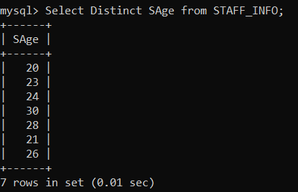
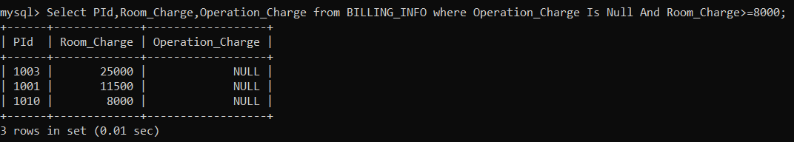
To display all distinct ages of staff members
Display PId, Operation charge, Room charge of patients whose Operation_Charge Is Null And Room_Charge>=8000

Slide 20
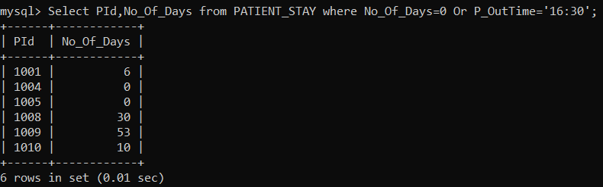
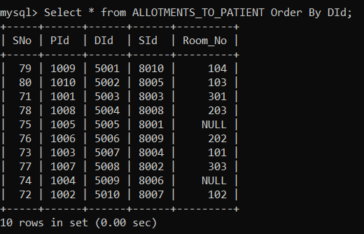
Display PId, number of days of stay of patients whose No_Of_Days=0 Or P_OutTime='16:30'
To display all columns of Allotments_to_patient table ordered by Doctor Id

Slide 21
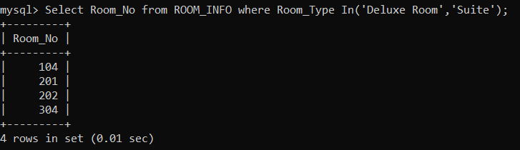
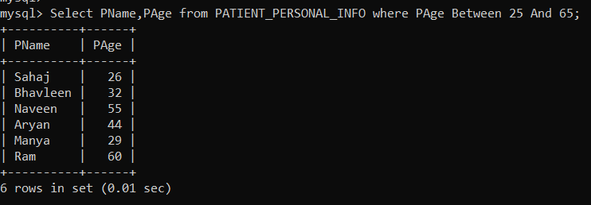
Display room number of rooms of type deluxe rooms, suite
Display name and age of patients having age between 25 and 65

Slide 22
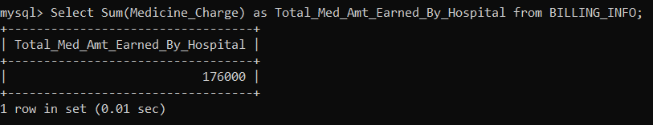
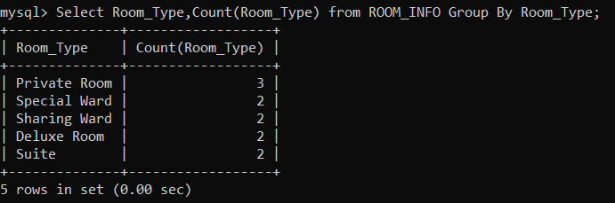
Display sum of all the medicine charges earned by the hospital
Display types of rooms and their count , grouping by room type

Slide 23
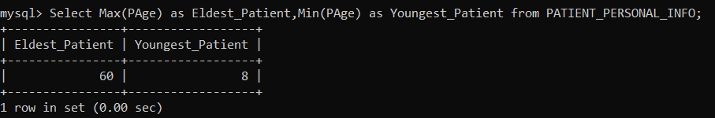
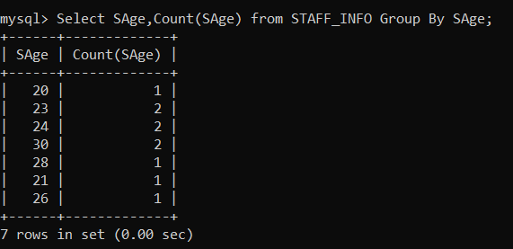
Display age of eldest and youngest patient
• To display the count of each age of staff

Slide 24
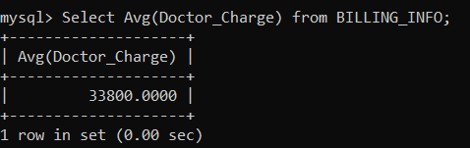
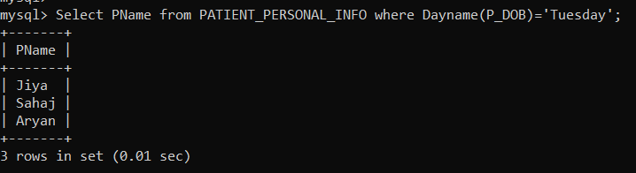
What is the average charges charged by the doctor?
Display the name of the patients who were born on Tuesday

Slide 25
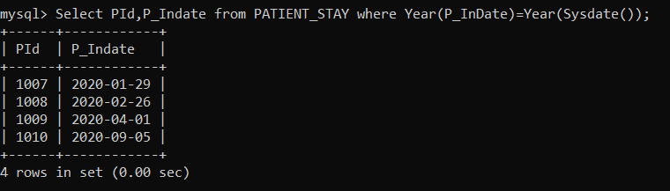
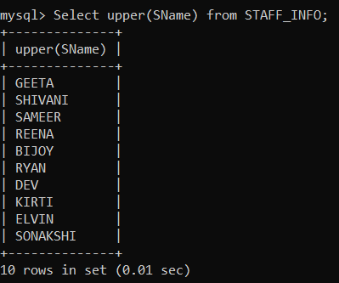
Display PId , Indate of patient who got admitted this year
Change all the staff names to uppercase

Slide 26
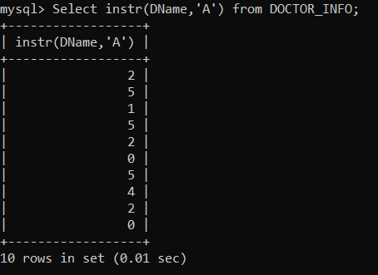
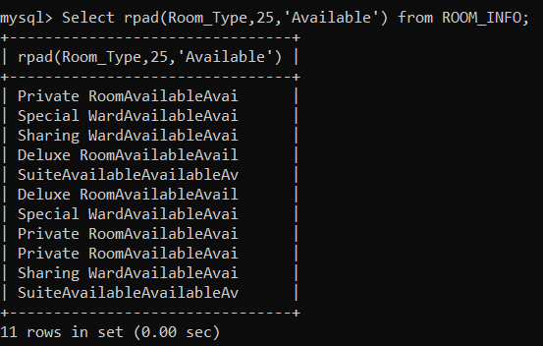
Gives The first position where A appears in doctor's name
Adds available many times till 25 spaces

Slide 27
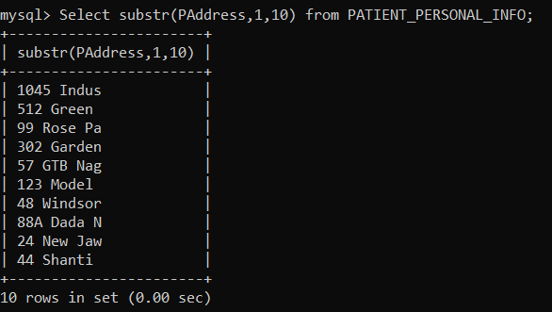
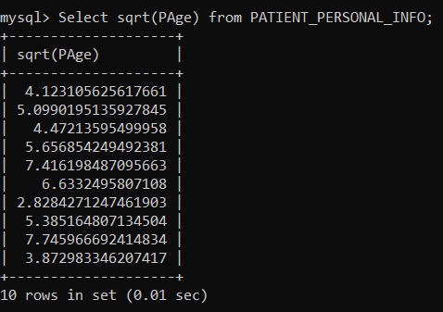
Gives 10 characters of patient's address from first character
Display the square root of ages of the patients

Slide 28
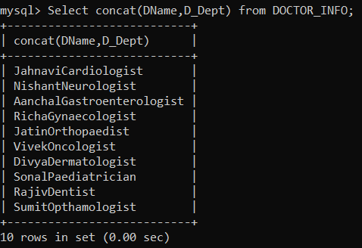
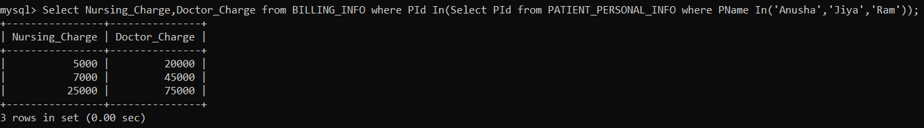
Merge the doctor’s name and department
Display the nursing charge and doctor charge of Anusha, Jiya and Ram

Slide 29
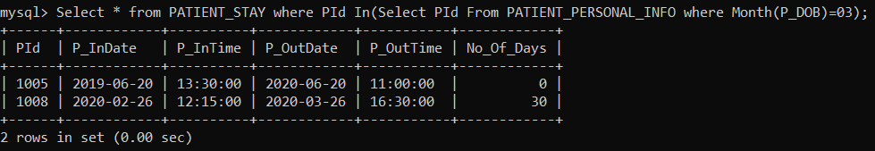
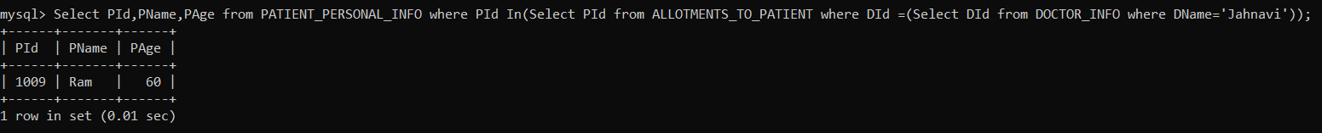
Display all columns of table Patient_stay for patients born in the month of march
Display PId, name and age of the patients treated by doctor Jahnavi

Slide 30
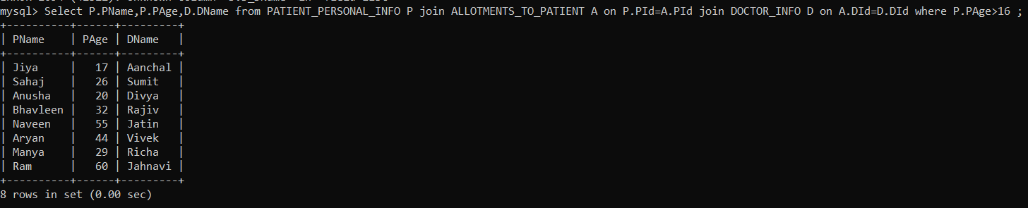
Display the room number and room type of Shaurya and Sahaj
Display the name , age of patient and the name of the doctor whose patient is above 16 years

Slide 31
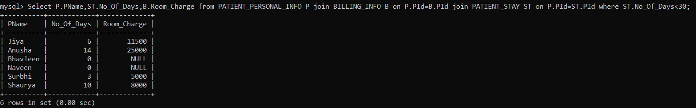
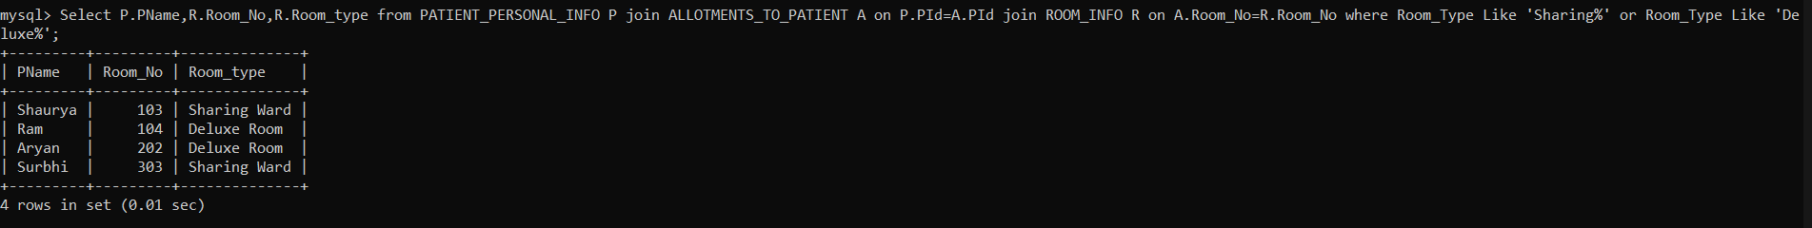
Display name, number of days of stay , room type of patient who stayed for less than 30 days
To get the room no and name of patient who are staying in deluxe type or sharing type of room

Slide 32
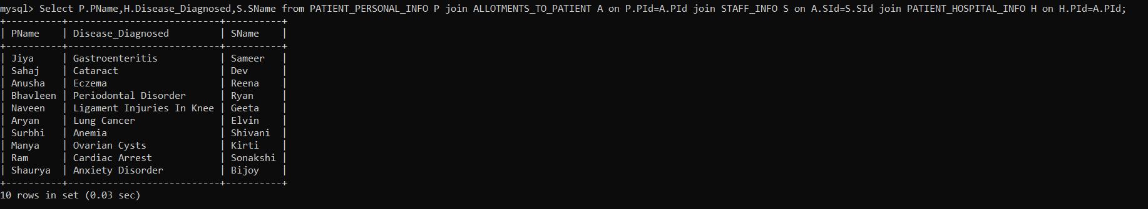

Display patient name, disease diagnosed and the name of the staff assigned to that patient
Create an Index for PATIENT_HOSPITAL_INFO table

Slide 33

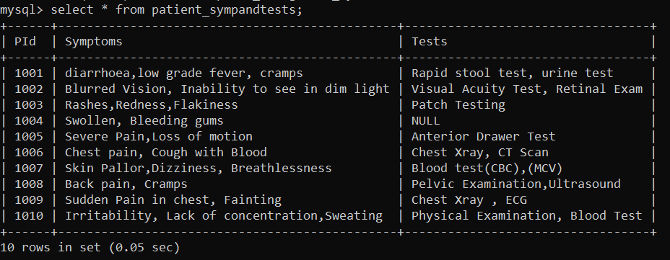
Create an unique Index for BILLING_INFO table
Create view for symptoms and tests of the diseases

Slide 34
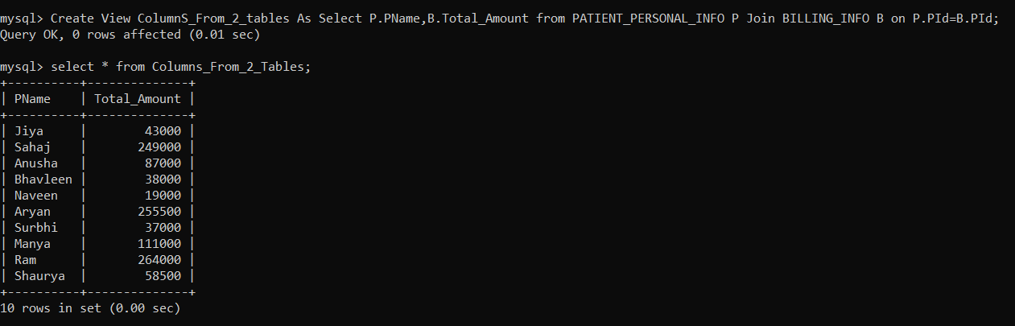
Create view for the patient name and the total amount he/she has to pay

Slide 35
THANK YOU

